Slide 1





Write Scalable and Extensible Node.js Applications using LoopBack 4

Slide 2


LoopBack Toronto Team
Diana Lau
dhmlau@ca.ibm.com
Janny Hou
juehuo@ca.ibm.com
@dhmlau
@jannyHou
Dominique Emond
dremond@ca.ibm.com
Agnes Lin
agneslin.lin@ibm.com
@emonddr
@agnes512

Slide 3

Let’s Run a Few Polls
Do you work on Node.js applications, frameworks, or modules?
Do you think your Node.js project is large scale?
What are the characteristics of a large scale Node.js project?

Slide 4



A Large Scale Node.js Application
# of Teams, Developers, Users
# of NPM Packages, GitHub Repos
# of Years & Releases of Development and Maintenance

Slide 5



LoopBack – a large scale Node.js framework
8 Full-time Maintainers
+ Many Community Contributors
12,000+ GitHub Stars
50+ NPM Modules
Created 5+ Years Ago
2 Major Releases (v3 and v4)
150,000+ Monthly Downloads

Slide 6

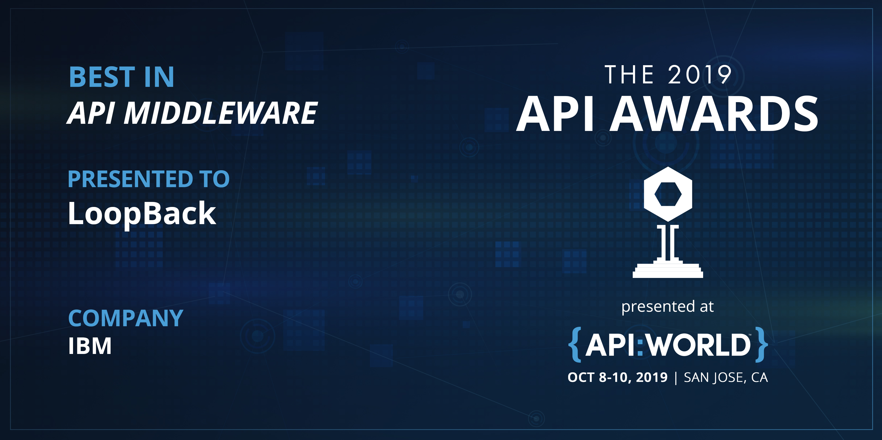

Slide 7




Challenges We Addressed
Customize the behavior of certain features
Extend the capabilities of your framework/application
Decompose a sequence of processing flow into actions
Compose a set of actions into a meaningful flow/sequence
Notes:
Customize the behavior of certain features, for example, use a different algorithm to hash passwords, allow a different logger function, or replace the built-in access control
Extend the capabilities of your framework/application, for example, allow a new authentication strategy, connect to a different database, or support another object storage provider
Decompose a flow/sequence of processing into actions, for example, perform authentication and authorization, impose rate limiting, route to corresponding controllers/methods, and invoke business logic to produce the response
Compose a set of actions into a meaningful flow/sequence, for example, set up a pipeline to process HTTP requests/responses, or allow delegation from controllers to repositories/connectors to interact with databases

Slide 8
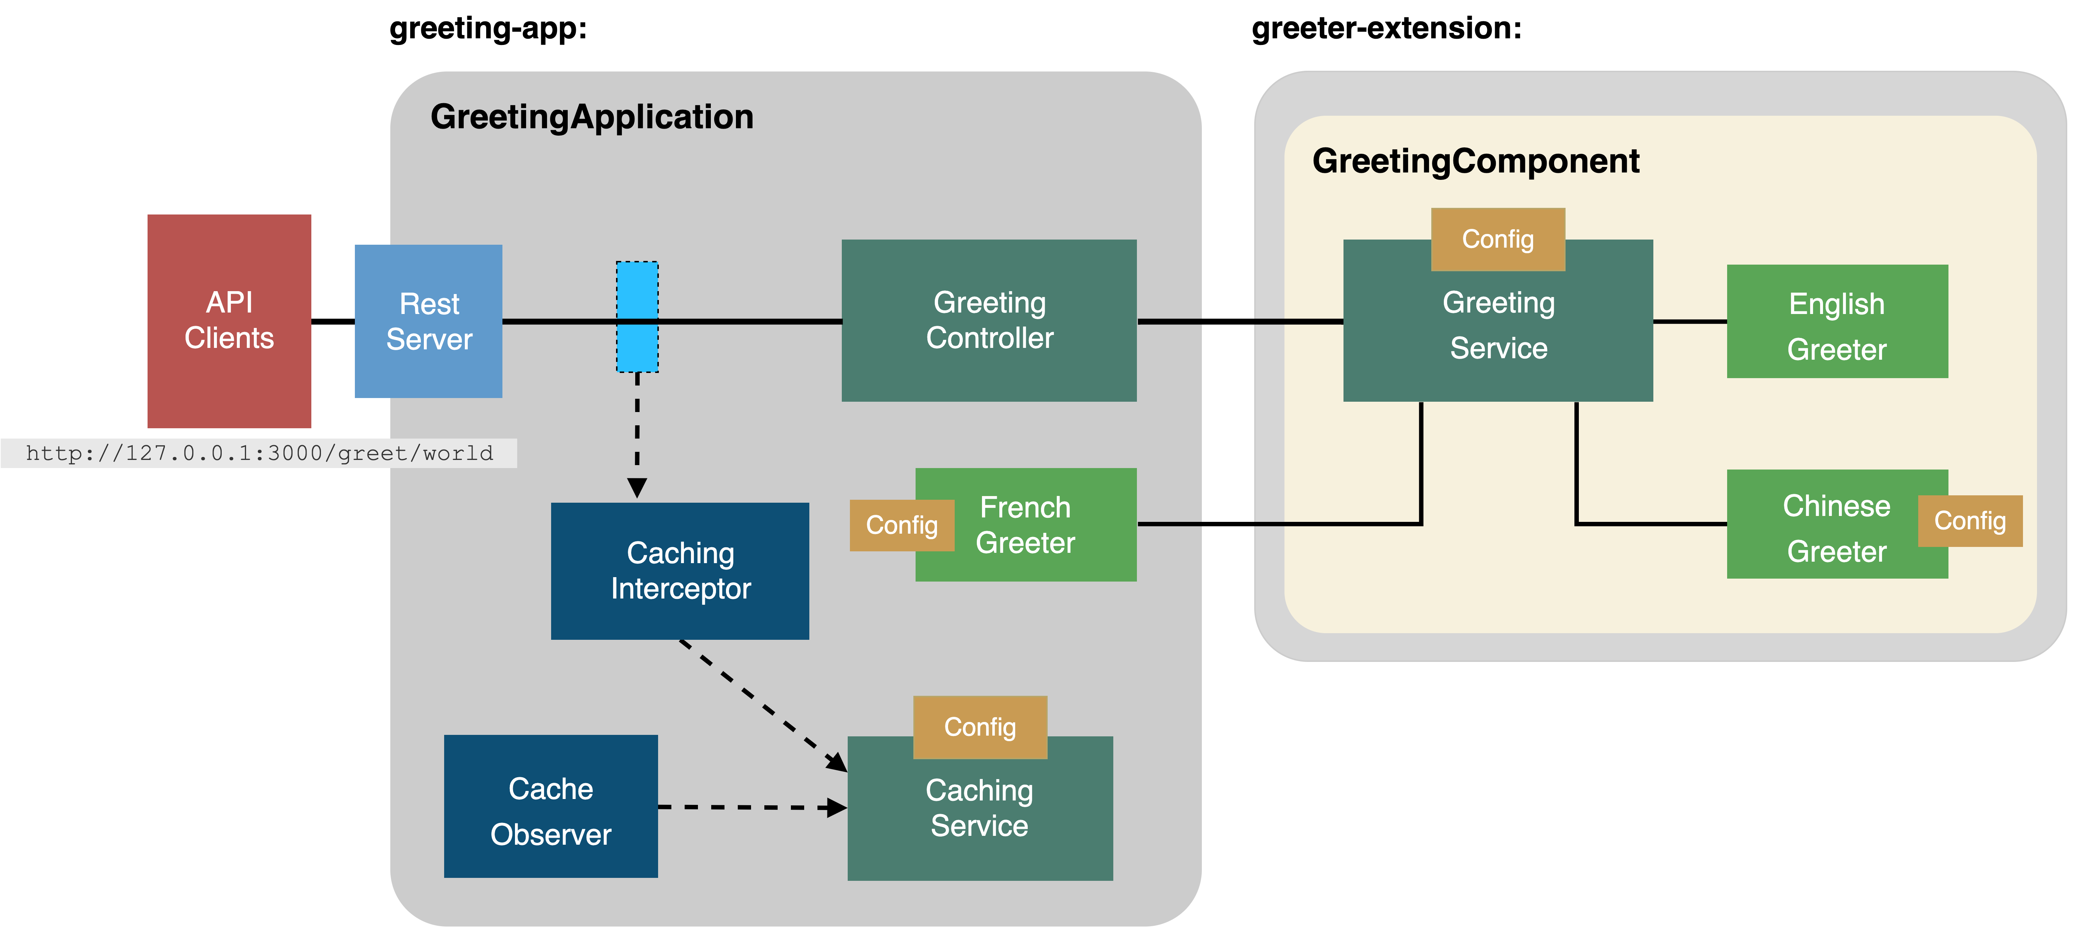
Application Scenario

Slide 9
Part 0 Before We Get Started
+ Install Node.js version 8.9 or higher
+ Set up development environment
+ Install LoopBack 4 CLI
$ npm i –g @loopback/cli
+ Clone our git repository
$ git clone https://github.com/strongloop/cascon2019.git
$ cd cascon2019
>> The code you need for the workshop are all in the instruction:
https://github.com/strongloop/cascon2019

Slide 10
Part 1
Enter the following command to start get started:
$ git checkout master
$ cd greeting-app
$ npm i

Slide 11


Part 1 Simple Application
Simple
One Module
Notes:
WHY
- Keep code loosely coupled
- Reduce the complexity of business logic in controller
WHAT
- Use Context, IoC, DI, Service
HOW
- Create an endpoint called “greeting”
- takes in a greeting word as input
- greeting message contains a timestamp
- The greeting message should be generated by a service
Steps
Scaffold app `lb4 app`
Create greeting controller `lb4 controller`
Define type `Message`
Create greeting endpoint with rest decorator
Inject service
Explain concepts
Create a mock greeting service
Try Get /greeting/{name}

Slide 12
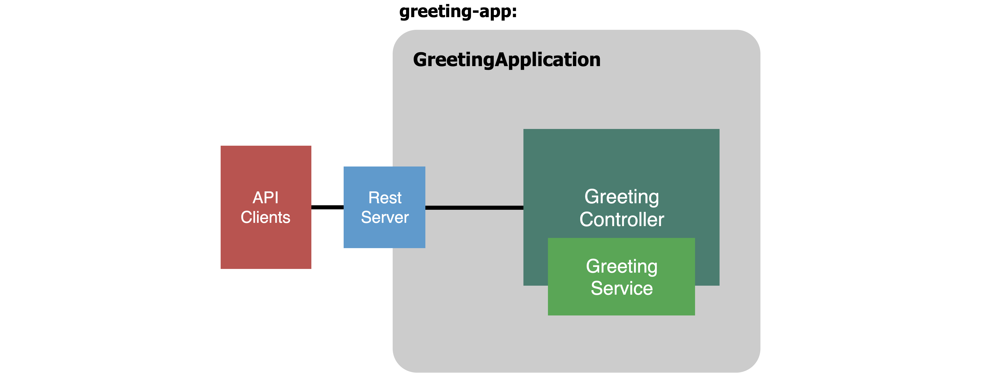

Slide 13
Part 2
If you haven’t finished the previous step,
enter the following commands to start on next part
$ git stash
$ git checkout workshop-part1-completed
$ npm i

Slide 14


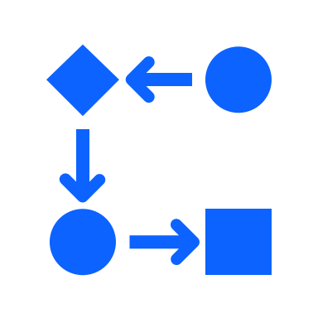
Part 2 Decouple the Application
Component
Dependency Injection
Binding
Inversion of Control

Slide 15
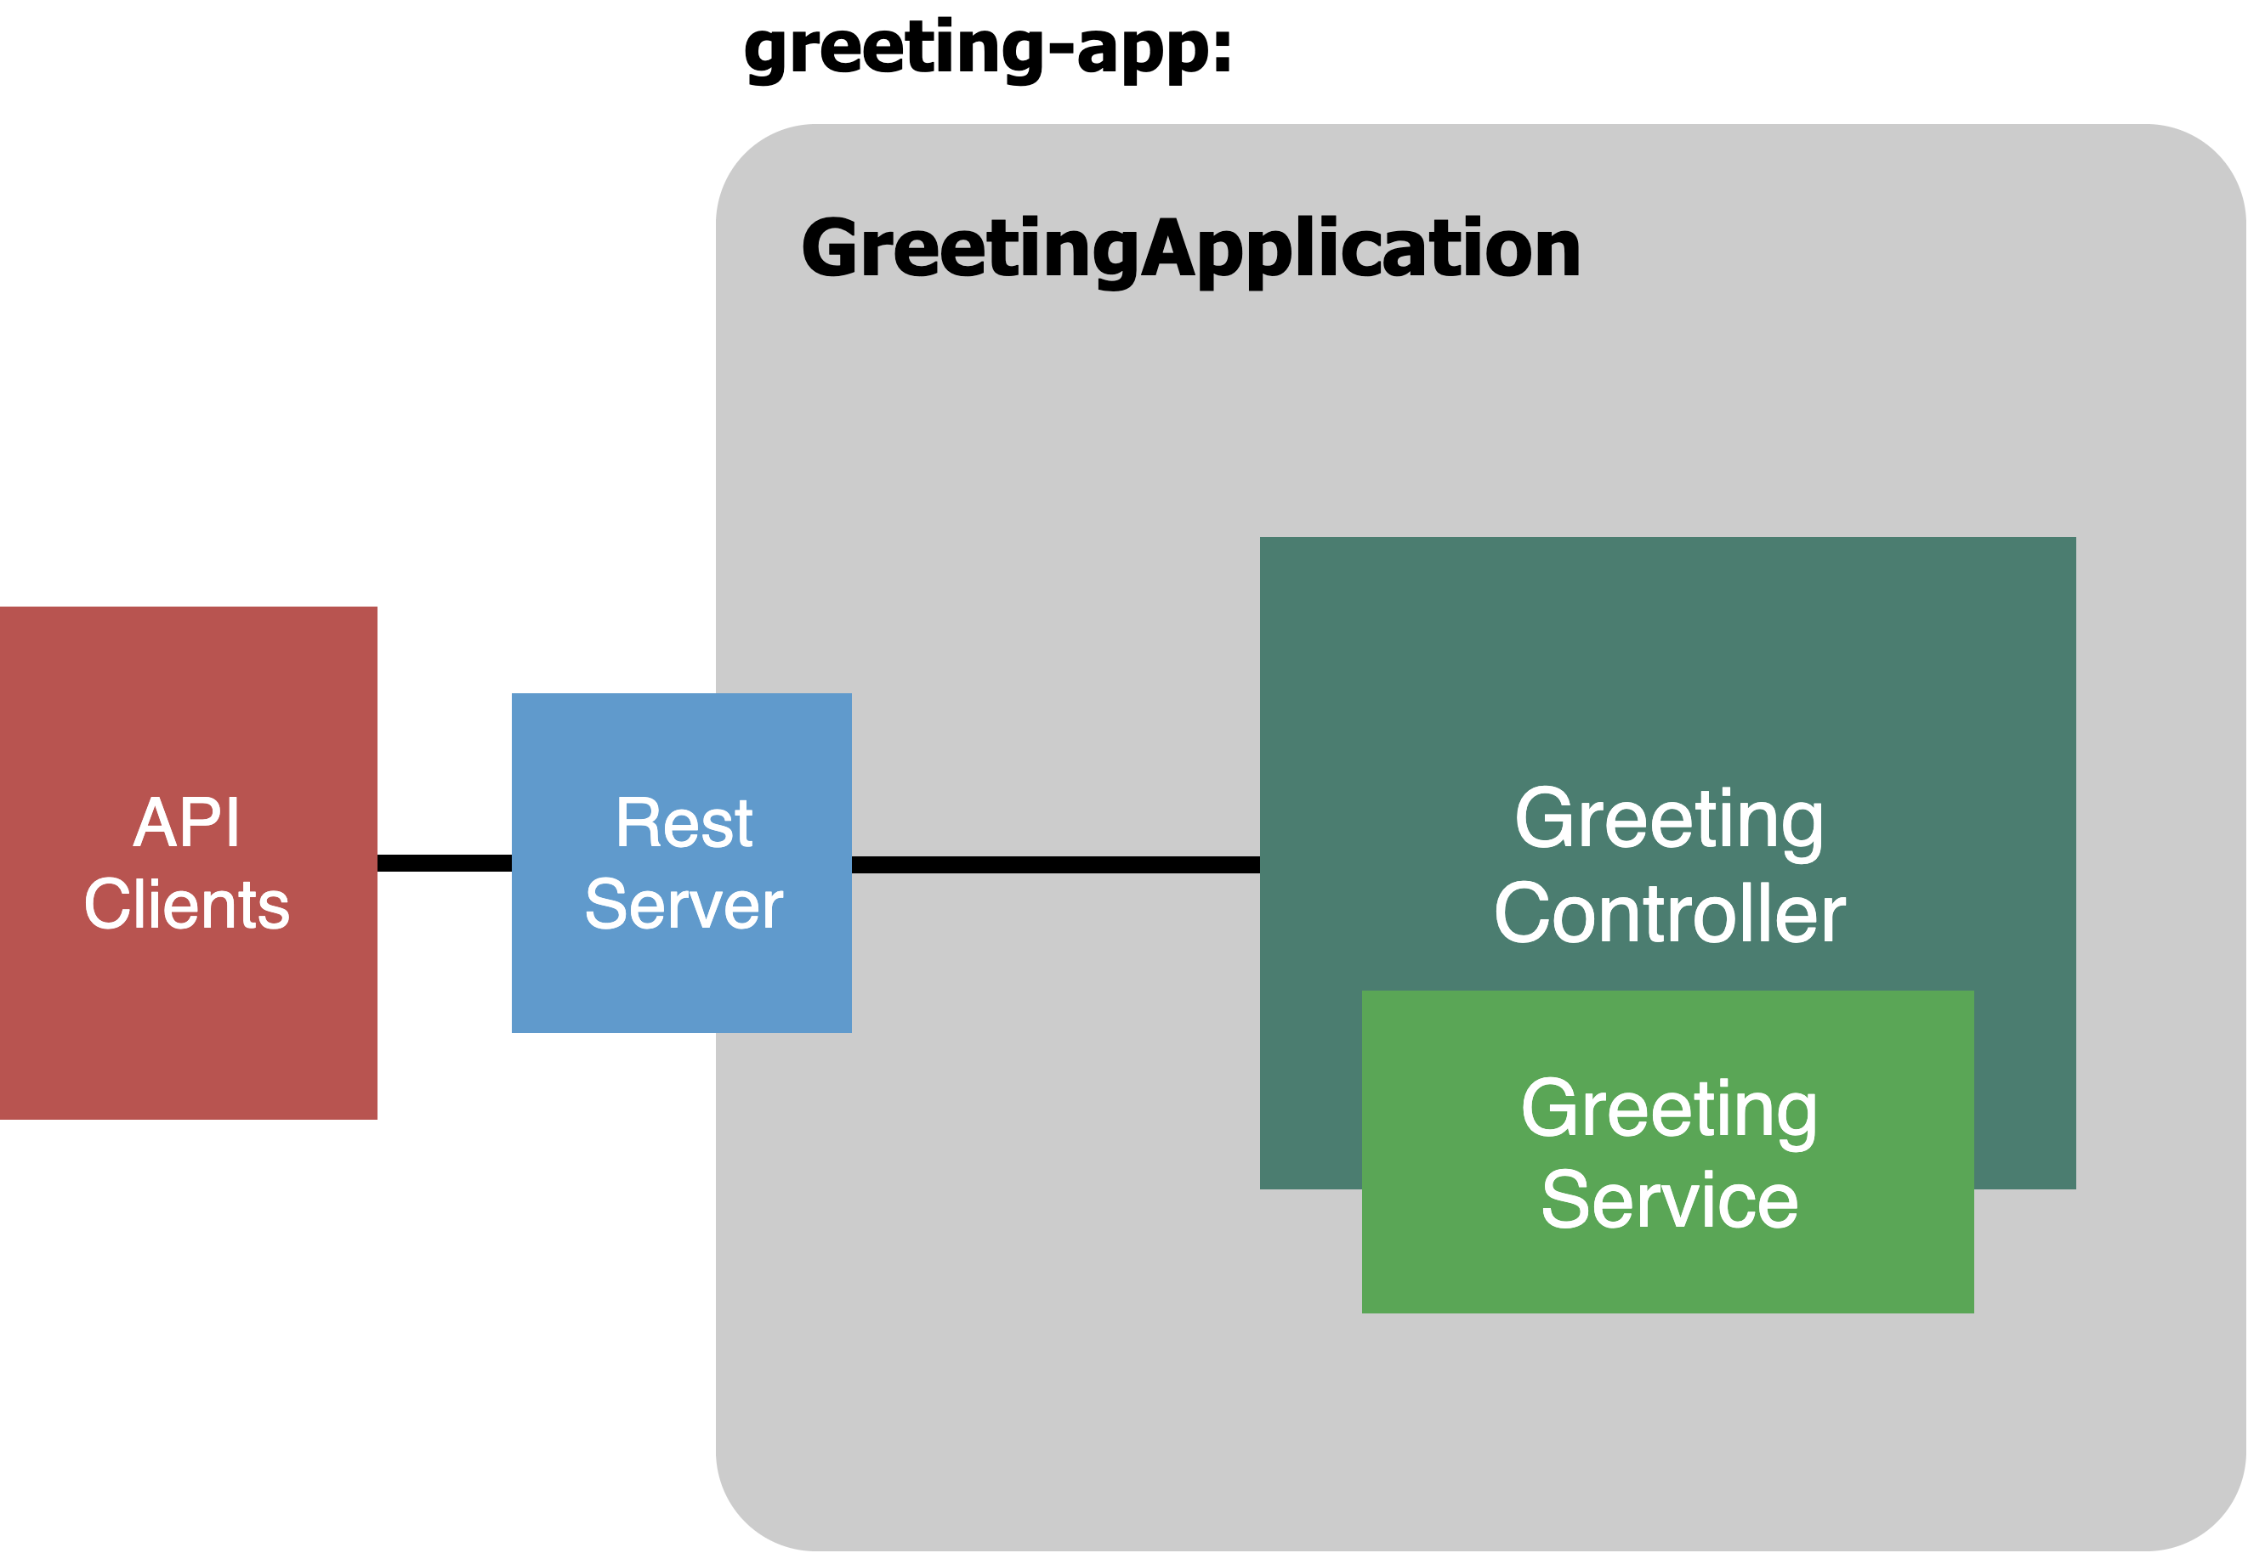
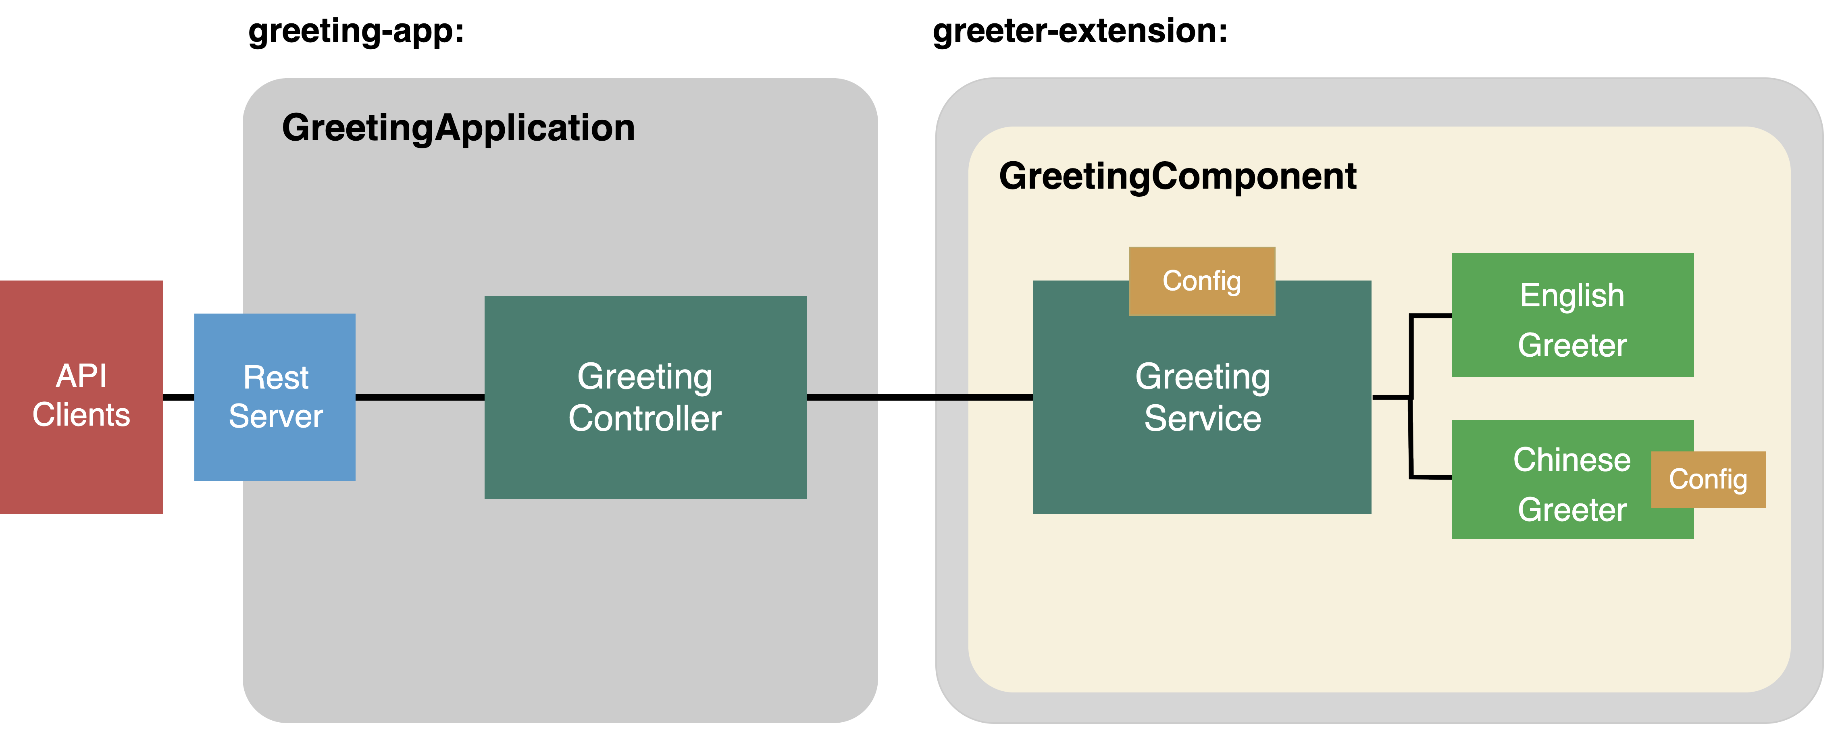
Separate into 2 modules

Slide 16
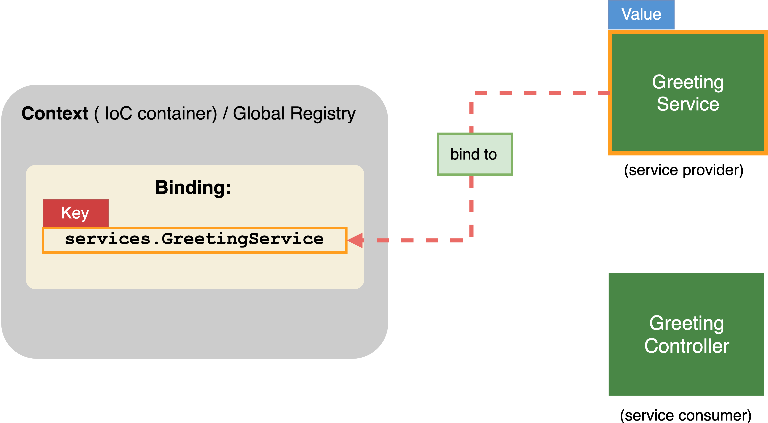
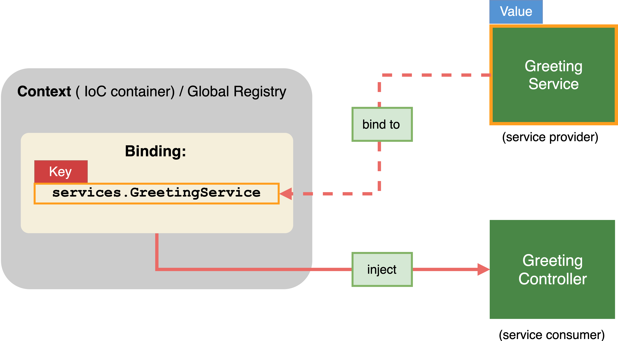
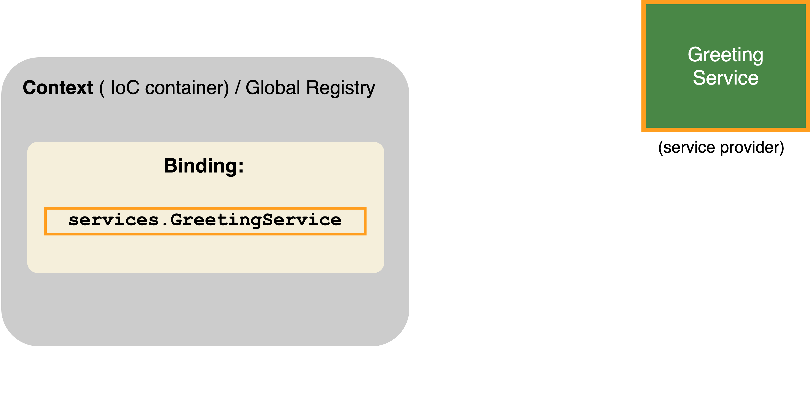
Binding
:
Key
Value

Slide 18
Part 3
If you haven’t finished the previous step,
enter the following commands to start on next part
$ git stash
$ git checkout workshop-part2-completed
$ npm i

Slide 19


Part 3 .1 Add a New Language Extension
Extension Point
Extension

Slide 20
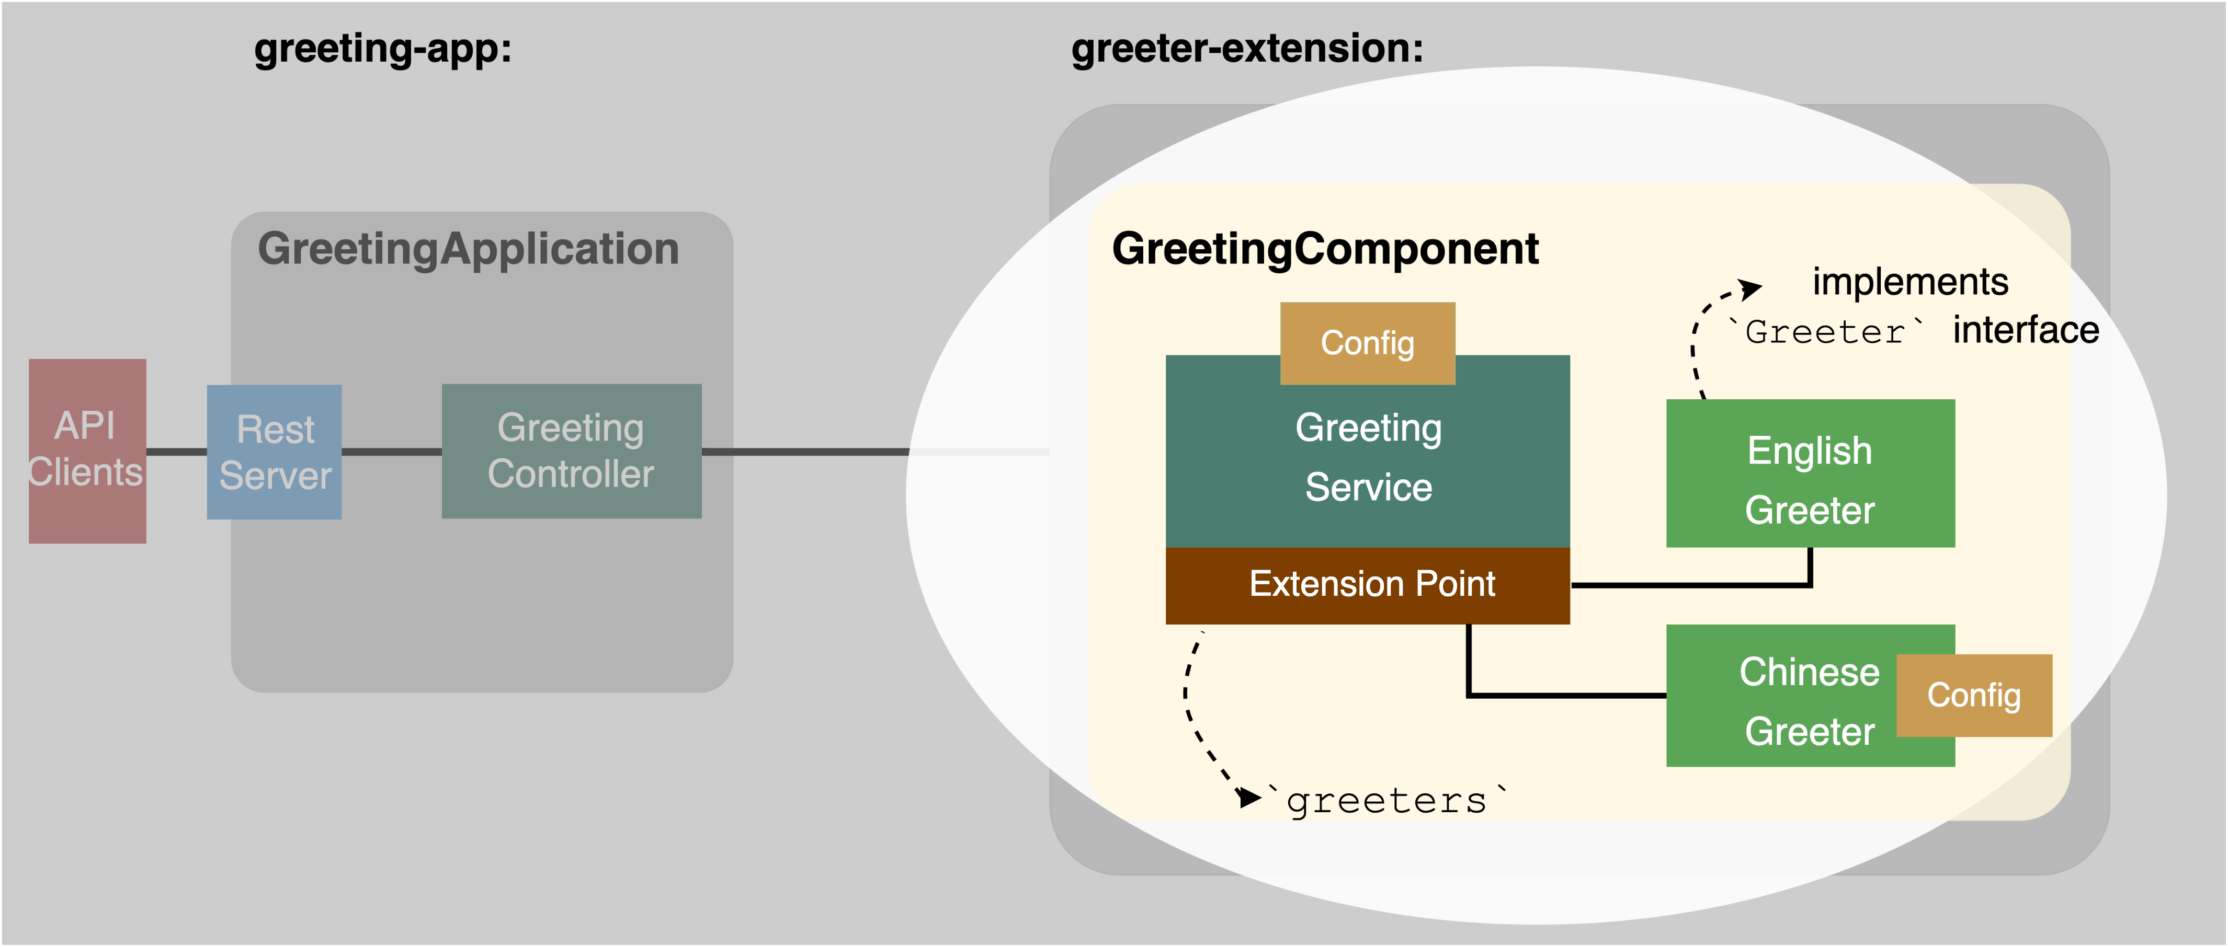
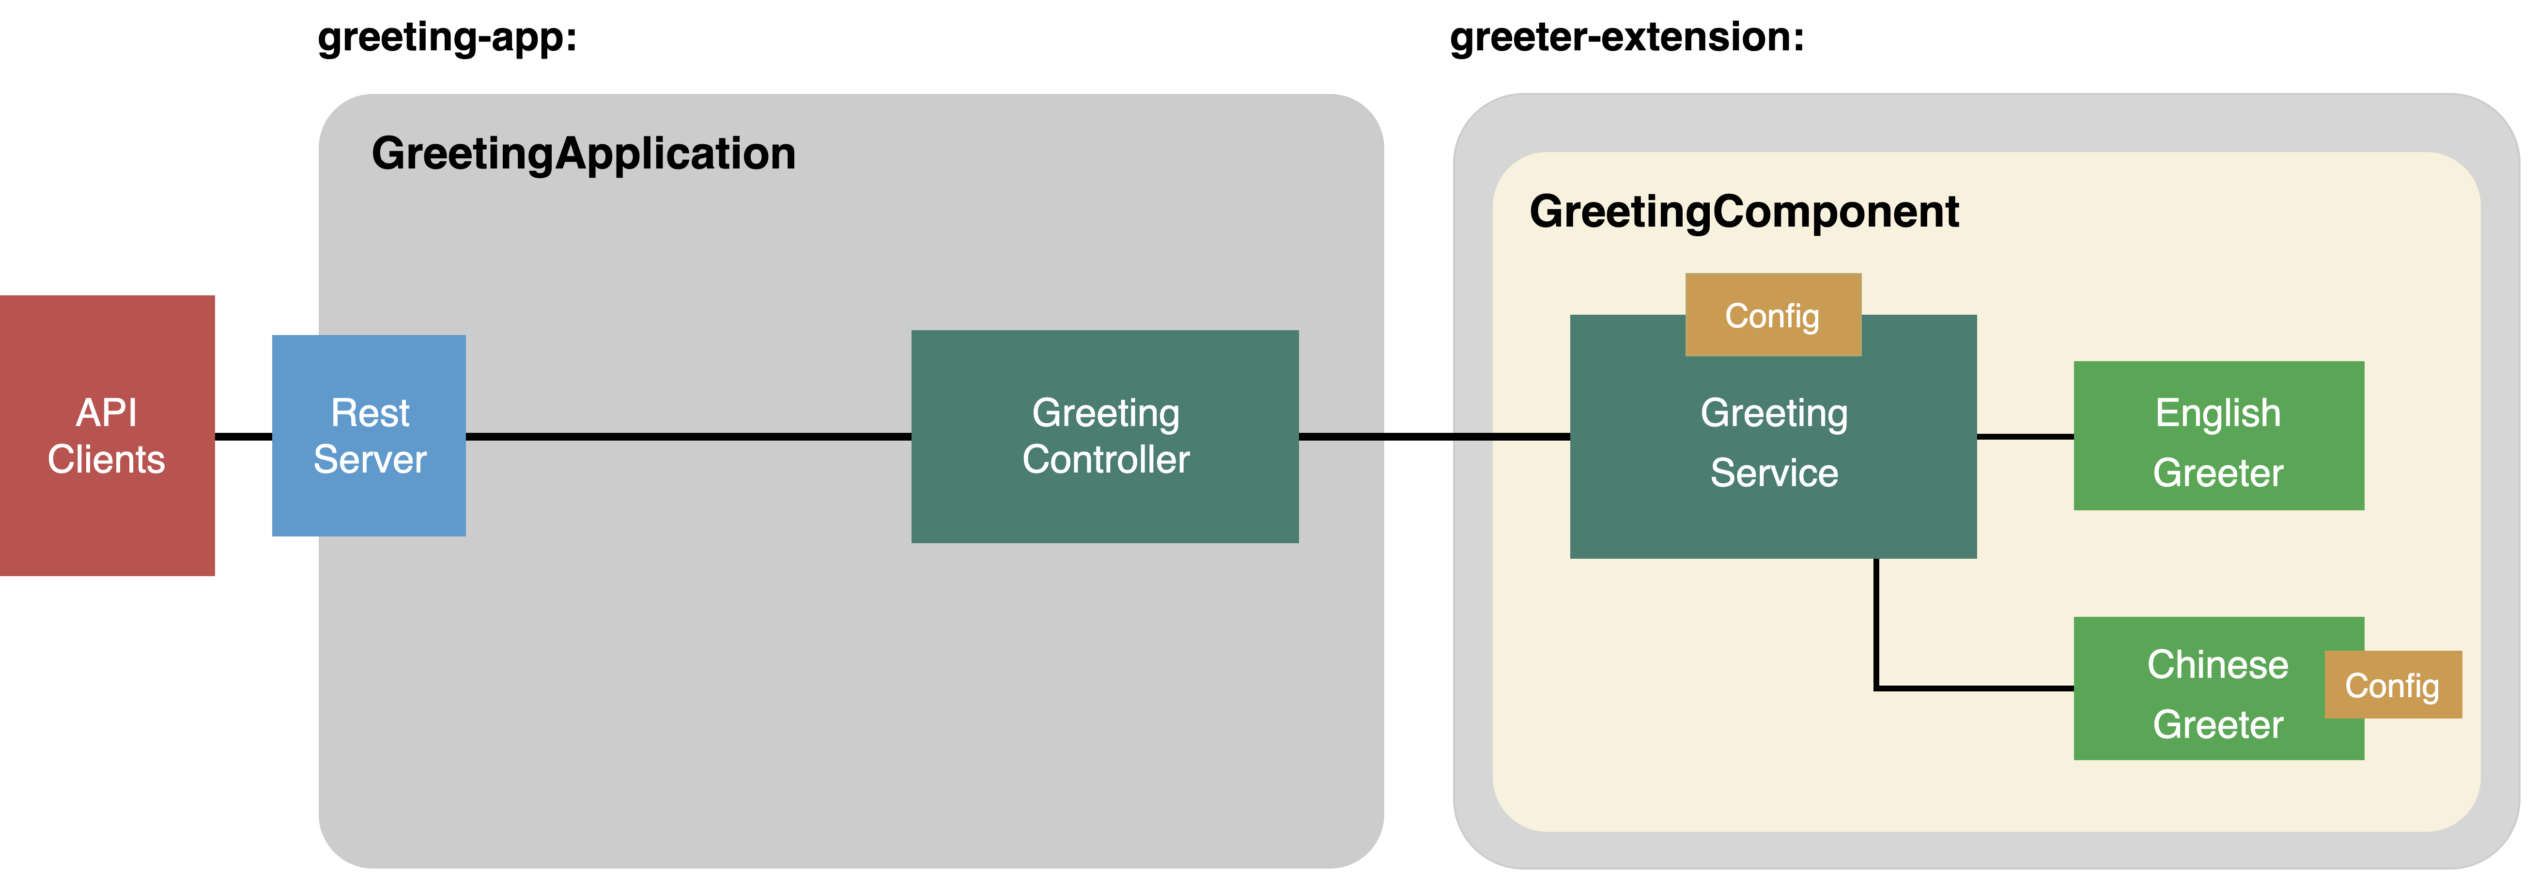
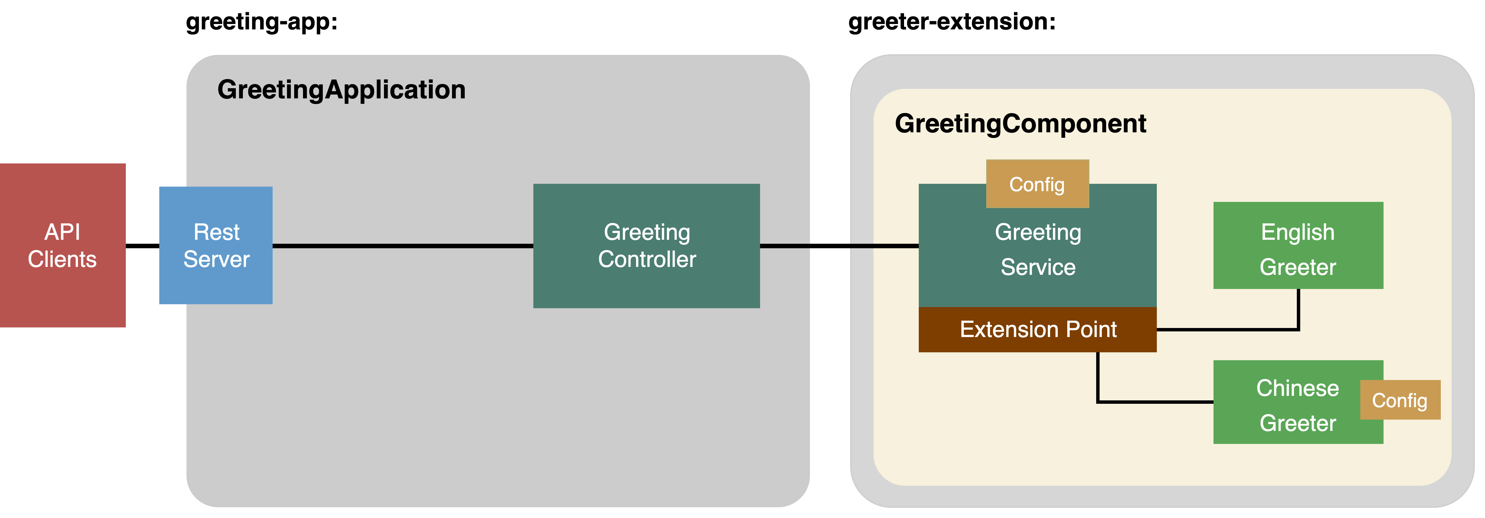

Slide 21
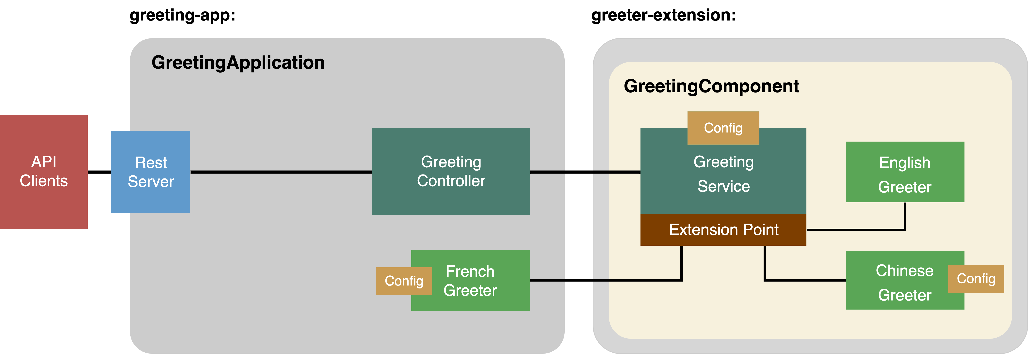

Slide 22
Part 3 .2 Configuration
Configuration

Slide 24
Part 4
If you haven’t finished the previous step,
enter the following commands to start on next part
$ git stash
$ git checkout workshop-part3-completed
$ npm i

Slide 25


Part 4 Enable Caching
Interceptor
Observer

Slide 26
Let’s Build a Caching System That Does:
+ Cache the result using the request’s URI and language as the key
+ The cached message has an expiration time
+ Expired messages will be swept out periodically

Slide 27
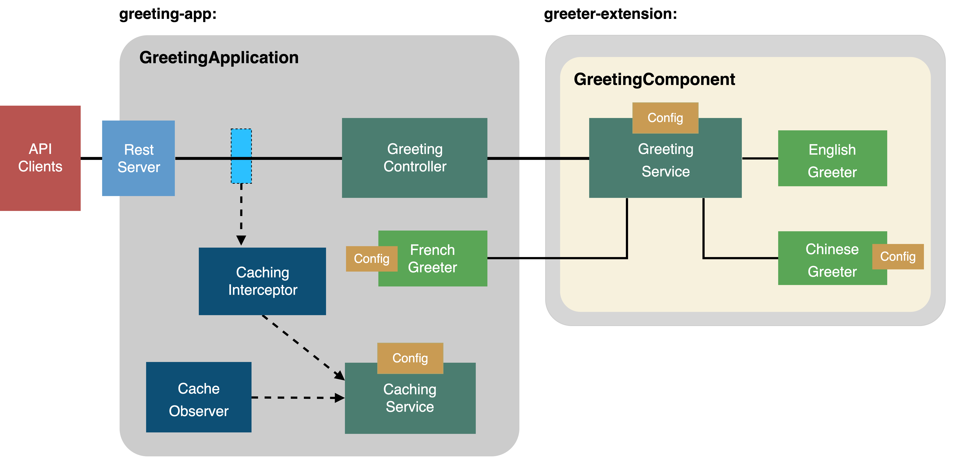
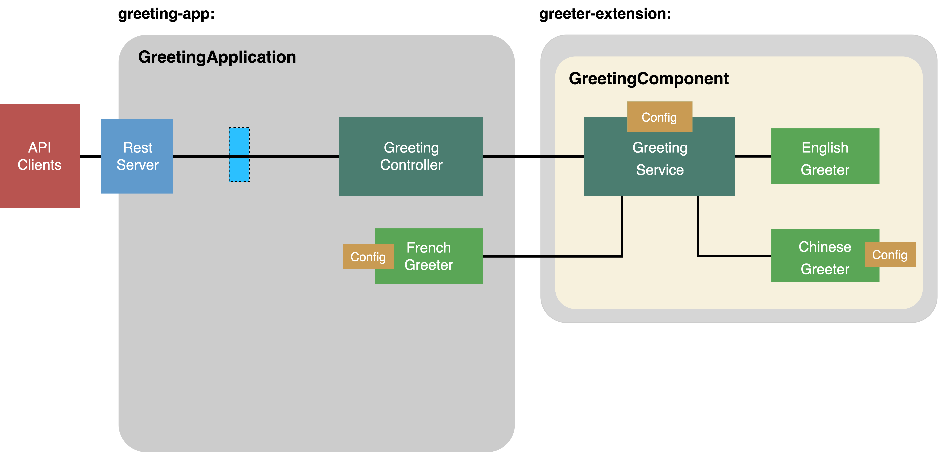

Slide 28
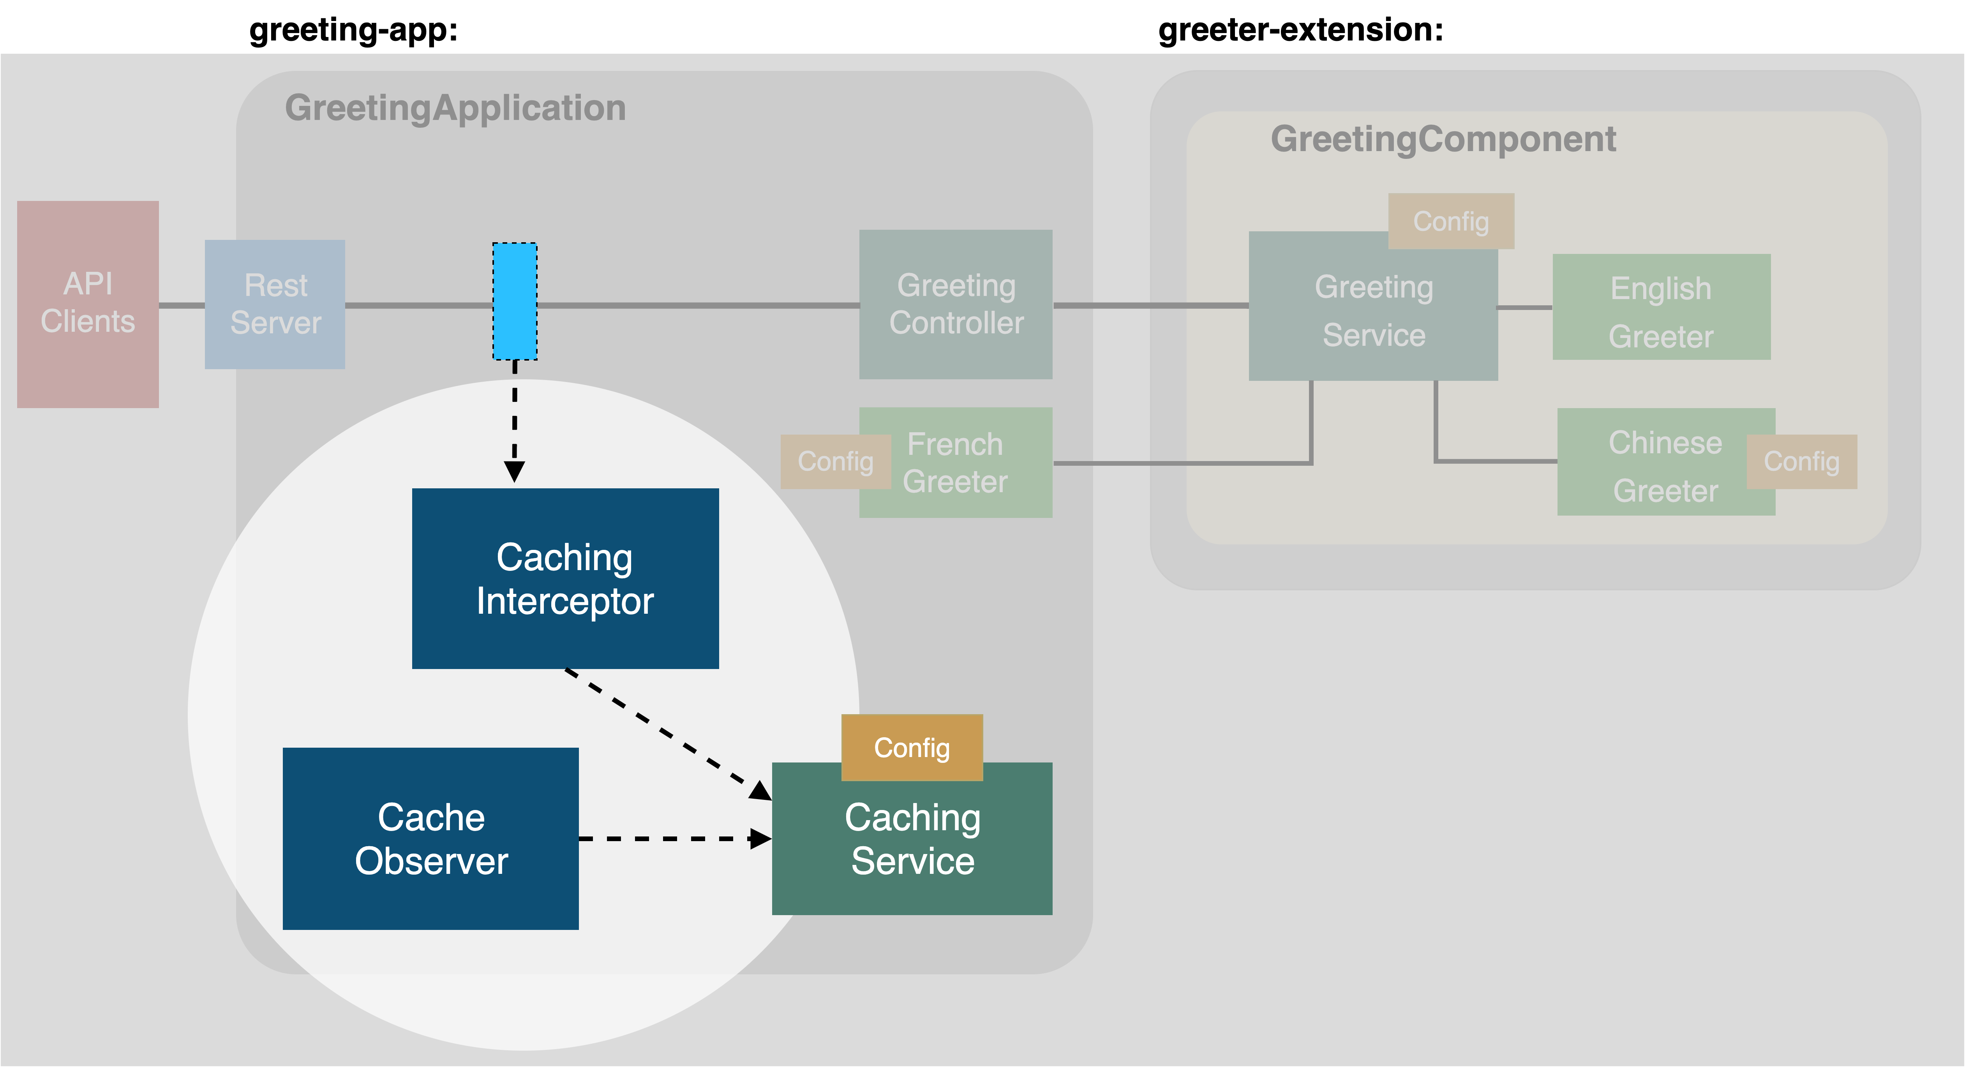
Cache messages
Return cached msg
Messages will expire
Start / Stop the caching service

Slide 30

Congratulations! You’ve completed the workshop
Built a LoopBack application and separated it into two modules.
Enriched the functionality of the app by adding extensions (FrenchGreeter).
Created a caching service that is started and stopped by a lifecycle observer.
Retrieved/stored request responses from/in the cache
with an interceptor.
You can find the completed code of this workshop in the git branch:
$ git checkout workshop-part4-completed

Slide 31


Thank You!
loopback.io
Strongloop/loopback-next
@StrongLoop

Slide 32
Acknowledgement
The LoopBack team at IBM and our contributors from the community
making good things happen in open source
Taranveer Virk and Raymond Feng - allowing us to reuse some of their slides
Iconography by FontAwesome is licensed under CC BY 4.0
Notes:
Customize the behavior of certain features, for example, use a different algorithm to hash passwords, allow a different logger function, or replace the built-in access control
Extend the capabilities of your framework/application, for example, allow a new authentication strategy, connect to a different database, or support another object storage provider
Decompose a flow/sequence of processing into actions, for example, perform authentication and authorization, impose rate limiting, route to corresponding controllers/methods, and invoke business logic to produce the response
Compose a set of actions into a meaningful flow/sequence, for example, set up a pipeline to process HTTP requests/responses, or allow delegation from controllers to repositories/connectors to interact with databases

